Slide 1
Money and banking

Slide 2
The History of Banking
1791: The First Bank of the US was established to hold the government’s $$, help the government to tax, regulate commerce, and issue a single currency
1861: The Second Bank of the US was established to restore stability and order to the monetary system.
1837 – 1863: During the “Wildcat” Era there many state-chartered banks, it was common for bank runs to occur, and there was wide spread panics
1907: The Panic of 1907 led Congress to create the National Monetary commission in 1908
1913: congress created the Federal Reserve System by passing the Federal Reserve Act. The Fed was the nation’s first true central bank; the notes it issued are the currency we use today.
1930 – 1933: congress forced the Fed to take action too late, meaning that recovery from the recession took a long time.
1935: congress adjusted the Federal Reserve’s structure so that the system could respond more effectively to future crises.

Slide 3
Federal Reserve Functions
Serve as banker for the US government and maintains a checking account for the Treasury Department
Regulates and stabilizes the nation’s money supply
Regulates and Supervises the banking system of the US

Slide 4
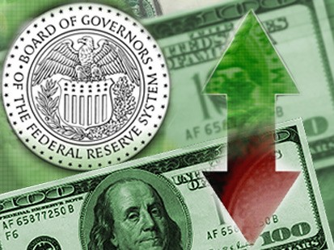
Federal Reserve Functions
Serves banks Nationwide: provides check-clearings services, safeguards banks reserves, and lends reserves to banks that need to borrow
Serves as financial agent for the Treasury Department and Other Government Agencies

Slide 5
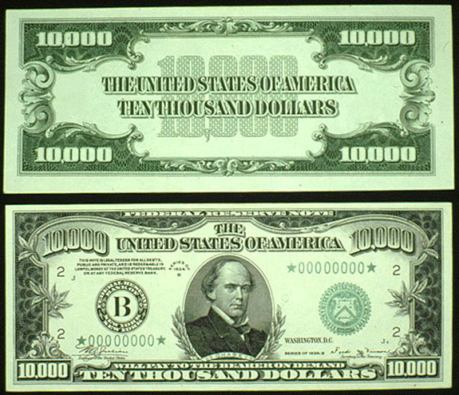
Federal Reserve Functions
Issues currency and makes sure that fresh bills are always in circulation

Slide 6
Functions of Financial Institutions
Storing Money – safe, convenient place for people to store money.
Saving Money – many ways to save money – savings accounts, checking accounts, money market accounts, and certificates of deposit
Loans – provide loans to those with good ideas

Slide 7
Functions of Financial Institutions
Mortgages – provide loans so people can purchase homes
Credit Cards – provide cards so goods will be paid for by bank, but card holder must pay the bank when due
Simple and Compound Interest – price paid for the use of money

Slide 8
Types of Financial Institutions
Commercial Banks – offer a wide variety of services – Bank of America
Savings and Loan Associations – very similar to commercial banks
Savings Banks – for people who are depositing $$ but not enough for a CB
Credit Unions – cooperative lending associations for particular groups, usually employees of a specific firm

Slide 9
Types of Financial Institutions
Finance Companies – installment loans to customers [like when you buy a car]

Slide 10
Electronic Banking
ATMs – very convenient for bank and customer since they are 24 hour operations, you can do many things at the ATM – check balance, withdraw money and sometimes deposit money
Debit Cards – very much like a credit card [but not as protected] to help protect customer, PIN numbers may be used – this allows the bank to directly take $$ from your account and give it to the store where you purchased something

Slide 11
Electronic Banking
Home Banking – many institutions allow for people to use their computer to direct deposit, pay bills on-line, shift $$ from one account to another via computer
Automatic Clearing Houses – automatically transfer $$ from person to creditor via Fed. Reserve Banks
Stored Value Cards – used on college campuses and other locations that have a magnetic strip or a computer chip with the amount of $$ in an account.

Slide 12
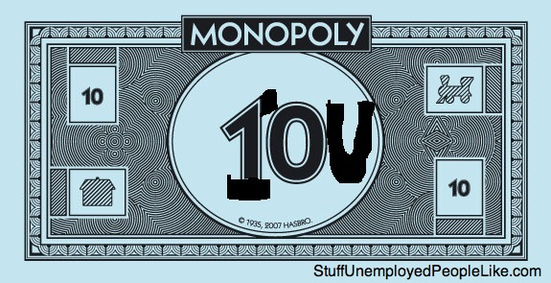
Money
Commodity money – objects that have value in themselves and that are also used as money. Cattle, salt, gems/rocks
Representative money – objects that have value because the holder can exchange them for something else of value. IOU, paper receipts for gold/silver

Slide 13
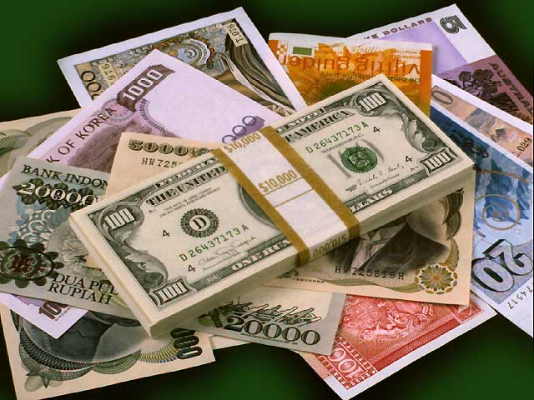
Money
Fiat money – money that has value because the government has ordered that it is an acceptable means to pay all debts. US currency, Australian dollar

