Slide 1
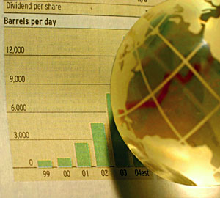
Economic Basics

Slide 2
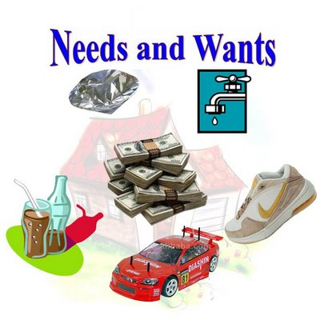
What is Economics?
The study of how people seek to satisfy their needs and wants by making choices

Slide 3
Macroeconomics
examines economy-wide phenomena such as changes in unemployment, national income, rate of growth, gross domestic product, inflation and price levels

Slide 4
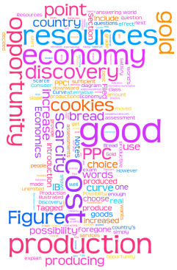
Microeconomics
analyzes the market behavior of individual consumers and firms in an attempt to understand the decision-making process of firms and households

Slide 5
Scarcity and The Factors of Production
What is a need?
Something that is necessary for survival
What is a want?
An item that we desire but is not essential to survival

Slide 6
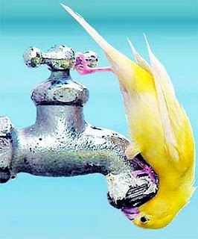
Scarcity and The Factors of Production
What is scarcity?
Scarcity is the idea that quantities of resources are limited to meet the unlimited wants of humans.
Scarcity can be temporary or long term
Scarcity is brought about by wars, famines, floods, fires, etc.

Slide 7
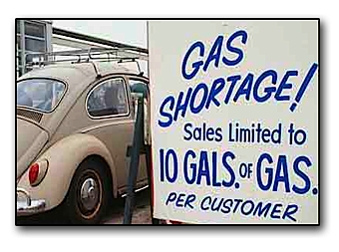
Scarcity and The Factors of Production
What is a shortage?
A situation in which a good or service is unavailable

Slide 8
Scarcity and The Factors of Production
What are the four factors of Production?
Land – the natural resources that are used to make goods and services
Labor – the effort that people devote to a task for which they are paid
Capital – any human made resource that is used to create other goods and services
There is human and physical capital
Entrepreneurs – ambitious leaders who combine the land, labor, and capital to create and market new goods and services

Slide 9
Trade – Offs and Opportunity Costs
What is a trade-off?
Trade offs are alternatives that we sacrifice when we make a decision.
What is an Opportunity cost?
The most desirable alternative given up as the result of a decision is an opportunity cost.
Example: If you buy a Big Mac Combo, you cannot go buy a Chicken McNugget Combo

Slide 10
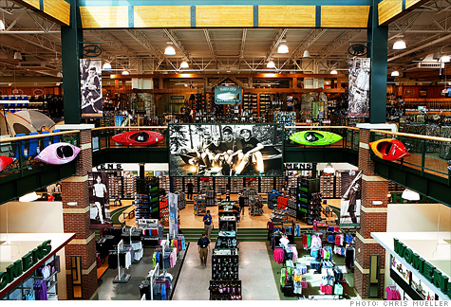
Goods
possessions and personal property
articles of commerce; merchandise

Slide 11
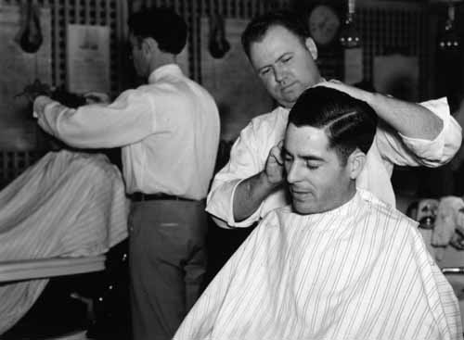
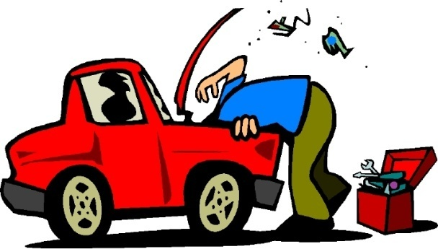
Services
useful labor that does not produce a tangible commodity
the maintenance or repair of tangible property service and improvement of the residence

